Slide 1
ALPHARD STAR
Institutional affiliation
Name
date
Notes:
explanation

Slide 2
Proper name of the star and Greek name
• proper name of the star is alphard and it was derived from al-fard
Notes:
The star that is readily seen in the skies of Lois Angeles is the Alphard star. The star is orange in color, and it is the brightest star in the Hydra constellation; it is brighter than the sun (Zari et al., 2018).. The star is called a solitary star since there is no other bright star near it. The name Alphard is derived from "al-fard," which means solitary one. It was given this name since Alphard's position in the sky does not contain other exceptional bright stars. The diagram below shows the Alphard star.

Slide 3
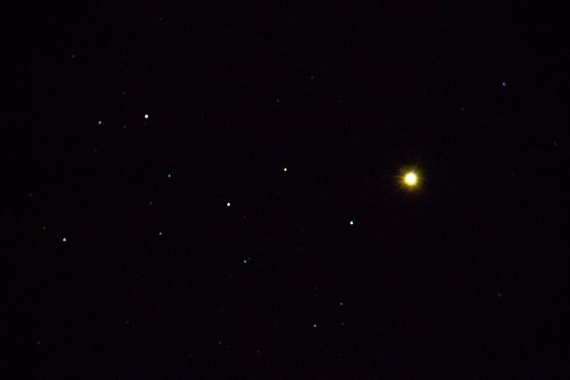
Spectral class and temperature of the star
• Formation of alphard star was 420 million years from dust and gas.
• the temperature of the star is 4120k
("Alphard (αHya)", 2021)
Notes:
The Tycho Brache named the star 'Cor Hydrae,' meaning the heart of the hydra since it marked the heart of celestial snakes. The Alphard star was formed 420 million years ago. It was formed from an interstellar medium of dust and gas. The temperature of the alphard star is around 4,120k, and it is near the center of the Hydra constellation The gravitational force pulled the dust and gases together, and when the right temperature was achieved, the brightest star was formed. Besides, the principal is brilliant in such a way it can be seen with naked eyes. The star is a slow spinner; hence it takes 2991 days to complete one rotation. Besides, it is a mild barium star, as shown in the diagram above.

Slide 4
Constellation of Alphard star
• Alphard star is in hydra constellation(water snake)
Notes:
The spectrum of the alpha star indicates excess barium that is an indication of the transfer of white dwarf companion. Astronomers have not found the white dwarfs; hence it is believed that they have faded away. Alphard star belongs to the hydra constellations. A Hydra constellation is also known as a water snake and is the largest constellation in the sky. It lies in the hemisphere that is to the southern side of celestial and stretched across 102.5 degrees.

Slide 5
Myths of hydra constellation
water snake myth
The hydra constellation myth that represented Babylonian constellation
Notes:
The myth behind the hydra constellation is that it was named after the water snake from the myth about the crow. The legend on the crow tried to do tricks to god Apollo by blaming the snake (DeForest, 2018). The snake was blamed for its delay in giving some water to the god. Hydra is long and a thin constellation when viewed; thoe head of hydra is believed to lie at the north of the celestial equator, and the tail is believed to dip at a declination of 30 degrees south. Besides, the distance between the head and the bottom of the hydra is believed to be 85 degrees.
Furthermore, the hydra is the largest of the 88 constellations, and it has been measured to have a length of 1303 square degrees, and it is the longest of all other constellations. The most common constellations used in the grouping of stars are Leo, Libra, cancer, Pisces, and Gemini. Hydra constellation belongs to the family Hercules family of constellations, and it contains seven stars, namely Alphard, Ukdah, Zhang, Lerna, Ashlesha, and Felis.
The second myth, the Hydra constellation, is an adaptation of the Babylonian constellation, MUL.DINGIR.MUŠ represented a serpent and corresponded to hydra loosely. Besides, the other constellations corresponded to the Greek constellation Serpens. Furthermore, the Babylonian constellation was a representation of a hybrid serpent from the myths. Again, the hydra is believed to have nine heads, one of them being immortal. The immortal head depicted the celestial hydra. The star is a representation of 48 greek constellations that Ptolemy listed in the second century. The star is located in an area with few bright stars in the sky, making it not easily identified. When viewed, the Alphard star forms a triangular shape with Regulus and Procyon.

Slide 6
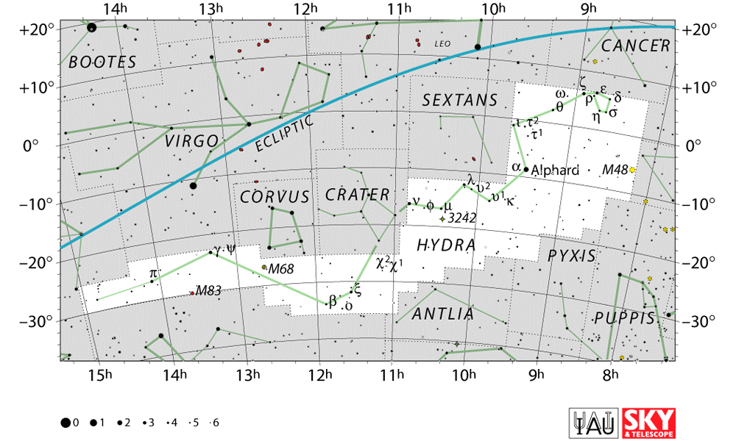
Events on the earth when alphard star emitted light
• the hydra constellation is located on second quadrant of the earth
• The star is located 177 light-years from the earth
• The angular diameter of the Alphard star is impressive and is only beaten by the Betelgeuse star. The estimated mass of the star is 3.03 solar masses.
The diagram below shows the hydra constellation's location.
Notes:
The Hydra constellation, where Alphard star is located, is in the second quadrant of the southern hemisphere and is seen in the latitudes +54 degrees and -83 degrees (Penprase, 2017). The star is very large and luminous. The star is said to be the backbone of the serpent since it is a single and giant star that is 50times larger and three times massive than the sun. The star is located 177 light-years from the earth. The temperature of the Alphard star is lower than that of the sun. The angular diameter of the Alphard star is impressive and is only beaten by the Betelgeuse star. The estimated mass of the star is 3.03 solar masses.

Slide 7
conclusion
Alphard star is expected to be a white dwarf in the future
it will likely form a planetary nebula and fade as a white dwarf
Alphard is the only nautical star in hydra.
Alphard was part of an asterism known as the red bird in China and the current world.
it is known as the first star of the star in China.
the name Alphard star is common on earth; hence a minivan called Alphard Toyota was named after this star and also, the star is featured on the Brazilian flag.
Notes:
In conclusion, Alphard star is expected to be a white dwarf in the future, likes its white elusive white dwarf. Besides, it will likely form a planetary nebula and fade as a white dwarf gradually when it reaches the end of its life. Alphard is the only nautical star in hydra. Furthermore, Alphard was part of an asterism known as the red bird in china and the current world; it is known as the first star of the star in china. Furthermore, the name Alphard star is common on earth; hence a minivan called Alphard Toyota was named after this star and also, the star is featured on the Brazilian flag.

Slide 8
References
DeForest, M. M. (2018). Apollonius' Argonautica: A Callimachean Epic. Brill.
Penprase, B. E. (2017). A World of Constellations in the Night Sky. In The Power of Stars (pp. 33-85). Springer, Cham.
Zari, E., Hashemi, H., Brown, A. G. A., Jardine, K., & De Zeeuw, P. T. (2018). 3D mapping of young stars in the solar neighbourhood with Gaia DR2. Astronomy & Astrophysics, 620, A172.
Alphard (αHya). Flickr. (2021). Retrieved 28 May 2021, from https://www.flickr.com/photos/bobfamiliar/5691741925.

